Slide 1
GRASP greedy randomized adaptive search
Multistage Job Shop Production Scheduling Problem

Slide 2
Multi-Stage Job-Shop Scheduling
Determine the optimal assignment of task to a machines considering time delivering and minimizing the cost.
Machines
4
1
5
8
Jobs
2
6
9
3
7
STAGE 1
STAGE 2
STAGE 3

Slide 3
Model formulation
Objective:
Find a feasible schedule, for each of the tasks, that minimizes the makespan (C_{max}) or completion time of the last task.
Subject to:
Each task is processed by only one machine for each stage.
Each stage has an assigned number of machines.
The completion time of each task should not exceed the delivery time.
Operations cannot be interrupted.
Each machine can process only one task at a time.
When initializing each machine, a set up time is applied.
Precedence restrictions between operations of different tasks.

Slide 4
INPUTS
OUTPUTS
Tasks (i)
Machines (m)
Stages (k )
Processing time
Set up time
Delivery time
Precedence relationship between task
SOLUTION METHOD
Assigment of task in the machines for each stage
Total makespan
VARIABLES
Assignment
1 is a task is assigned to machine m
0 otw
Sequence
1 if a task precede another task at specific stage
0 otw

Slide 5
Notation
Sets
Jobs {1,2,3,…,i,…,j,…,N}
Machines {1,2,3,…,m,…,M}
Stages {1,2,3,…,k,…,K}
M(k) Machines per stage
Parameters
T_{im}^{p} Process time
T_{m}^{s} Set-up time
T_{i}^{d} Due date
C_{i} Makespan
Is the distance in time that elapses from the start of work to the end

Slide 7
How to solve it?
The solution to this problem can be difficult due to the number of restrictions and all the possible solutions that can be generated.
Exact solution methods build an optimal solution from the problem data by following a series of rules that accurately determine the order of processing.
However, computational time grows exponentially with respect to the size of the input.
Although the approximation methods do not guarantee an exact solution, they are capable of obtaining solutions that are very close to the optimum, with moderate calculation times, and therefore more suitable for large problems.

Slide 8
GRASP (Greedy Randomized Adaptive Search Procedure)
Two phase metaheuristic used for combinatorial optimization
Built phase
Build an initial feasible solution
Local search phase
Search in the neighborhood of the feasible initial solution for an alternate solution that improves the objective.

Slide 9
GRASP
t_{min}≤ t_{i} ≤t_{min}+α(t_{max}-t_{min})
For task i built an ascendant list of processing times at machine m at stage k
Make a restricted list of candidate machines by stage
Set order assignment of task
Phase 1
Repeat the process until all tasks are assigned
Assign selection to partial solution
Random selection of machine assigned to task by stage
Initial feasible solution
Compute C_{max}
For task i in stage k reassign machine
Update C_{max}
Phase 2
Repeat until complete all task
If the solution improves then replace

Slide 10
Example 4 task, 4 machines, 2 stages
Jobs | Due Date | Processing time
 |  | M1 | M2 | M3 | M4
1 | 800 | 171 | 171 | 110 | 96
2 | 600 | 111 | 100 | 86 | 96
3 | 800 | 151 | 151 | 96 | 96
4 | 1000 | 161 | 161 | 90 | 96
SetUp Time |  | 80 | 80 | 40 | 40

Slide 11
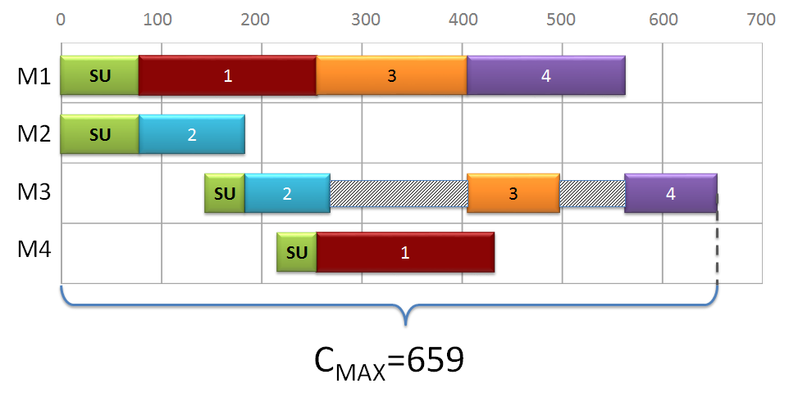
Greedy Solution

Slide 12
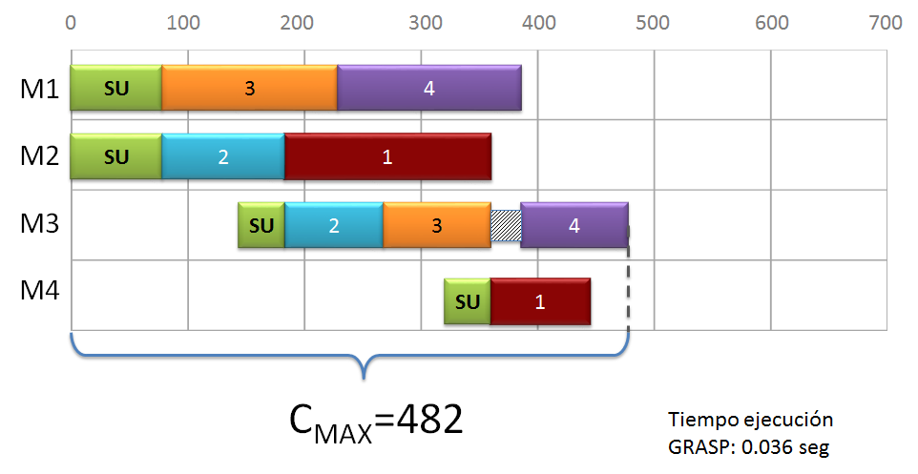
Solución fase 2

Slide 13
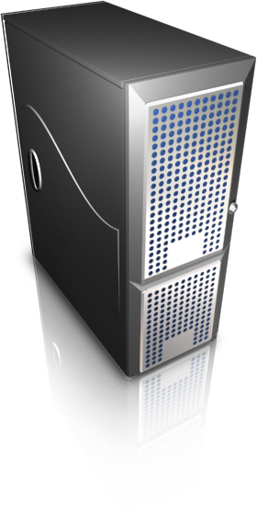

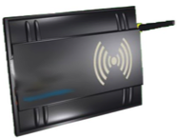

RFID Communication process
1
Reader broadcast signal through antenna
Tag receives signal and gets charged
2
5
Host Computer process information
Reader receives response and sends data to computer for processing
Charged tag sends its code
4
3

Slide 14

RFID Communication process
Interference
θ_{T},φ_{T}
Orientation
Distance (d)
θ_{R},φ_{R}
Reflection

Slide 15
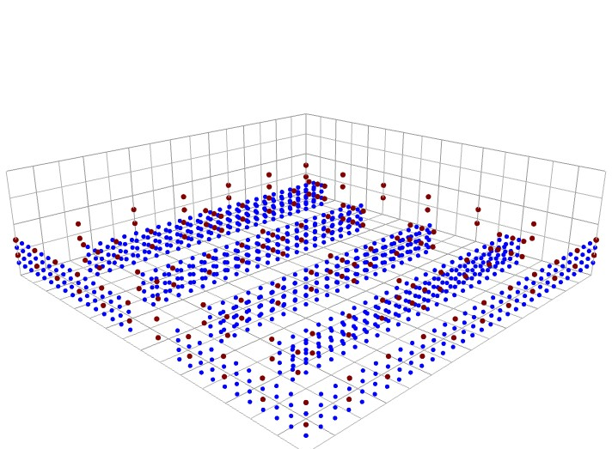
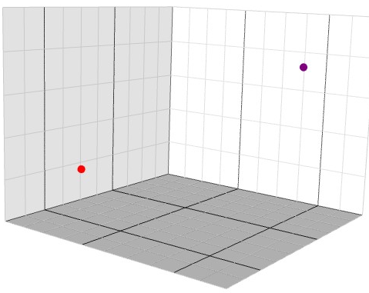

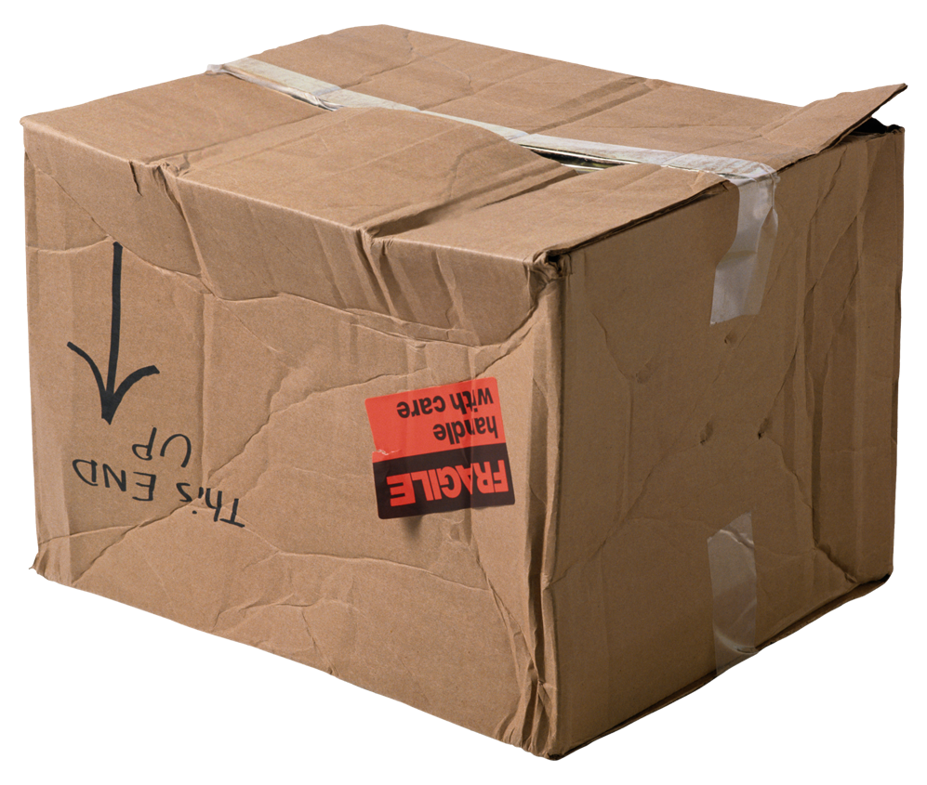
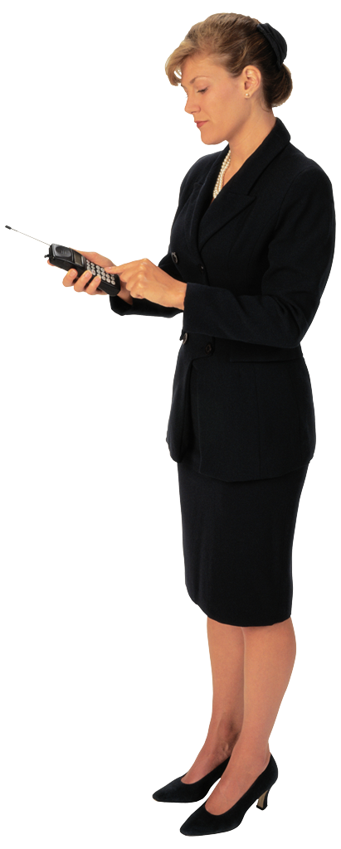

3-D Scenario
φ_{i}
θ_{j}
θ_{i}
φ_{j}

Slide 16
Friis equation
Free-space
path loss
Reflection
Loss
Misalignment of
the antenna pointing
Polarization
Loss

Slide 17
Communication process 3D

Slide 18
Problem description
Consider a set of RFID tags placed in M locations of a given area and N potential locations to position RFID reader antennae. It is desired to find the minimum number of reader’s antennae, and their positions, required to identify all tags in the area.
Determine number and position of the RFID readers that allow identifying the tags in the area of interest.

Slide 19
Notation
Symbol | Description
i | Sub index to denote reader candidate position. i={1,2,3,…,N}
j | Sub index to denote RFID tags. j={1,2,3,…,M}
S_{i} | Binary variable that takes a value of one if an antenna is placed in position i and zero otherwise.
R_{ij} | Binary variable that takes a value of one if an antenna placed in position i activates and identifies tag j and zero otherwise.
Q | Large number
T_{b} | Threshold value of power required to identify a tag.
T_{a} | Threshold value of power required to activate a tag.
P^{T} | Power transmitted
P^{R} | Power received

Slide 20
Notation
Symbol | Description
d_{ij} | Euclidean distance between reader in position i and tag j
G(θ, φ) | Angle dependent transmitter gain
θ | Antenna orientation with respect to the x-axis
φ | Antenna orientation with respect the reader axis and the x-axis
λ | Wavelength
τ | Reflection coefficient
û | Polarization vector
X | Random variable distributed N(0, α)
α | Interference level (Variance)
x, y, z | Position coordinates

Slide 21
Assignment Model
Objective Function
Constraints

Slide 22
Set-covering Model
Objective Function
Constraints

Slide 23
Comparison of models
Assignment model | Set covering model
A tag is officially activated and identified by the same reader. The communication process is guarantee with the first set of constraints. | Do not identify an official reader to activate and identify each tag The communication process is checked previously

Slide 24
Solution methods
Assignment model (branch and bound)
Set-covering model (branch and bound)
Greedy Randomized Adaptive Search Procedure (GRASP)
GRASP_LS

Slide 25
Exact methods
CPLEX is an optimizer that solves linearly constrained optimization problems. MIP problems are solved using branch and cut search.

Slide 26
GRASP metaheuristic
Greedy randomized adaptive search procedure (GRASP) is a multi-start metaheuristic for combinatorial problems, in which each iteration consists basically of two phases: construction and local search (Resende & Ribeiro, 2002).
The construction phase builds a feasible solution, whose neighborhood is examined until a local minimum is found during the local search phase.
The best overall solution is kept as the result.

Slide 27
GRASP metaheuristic
Start i=1
Update info
S=Total candidate
S’=empty
Tags
d_{ip}
N
Build CL
Y
S’<S
N
S=S
Build RCL
Y
Select candidate
S=S’
end
Max
Iter?
Incorporate to S’
i=i+1
Y

Slide 28
GRASP_LS

Slide 29
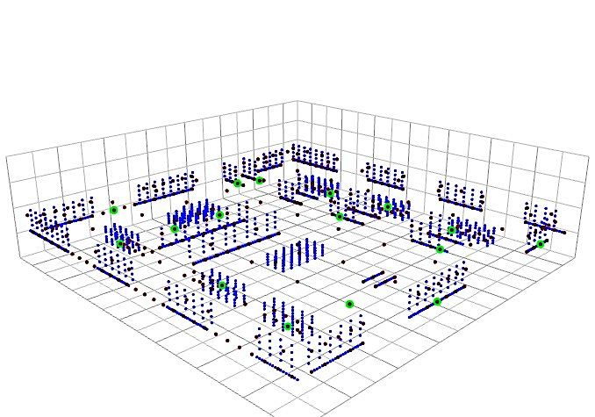
Solution
Tags
CPR
Solution

Slide 30
Complexity level
1710 3D instances

Slide 31
Time-Complexity level
1710 3D instances

Slide 32
Conclusions
Parameter | Assignment | Set-covering | GRASP | GRASP_LS
Time of solution | Increases with the instance |  | Increase with the number of iterations
 | Worst times of solution | Better times of solution than the assignment | Best times of solution | Better times than optimization models
Number of RFID reader | Small instances with lower level of complexity | Best solutions (some cases optimal) | Gap between -3% to 12% largest instances (maximum gaps are larger)
 | Quality decrease with the size of the instance and time limit | Better performance than the assignment model when the time limit is applied. | Negative gaps when the time limit is applied

Slide 33
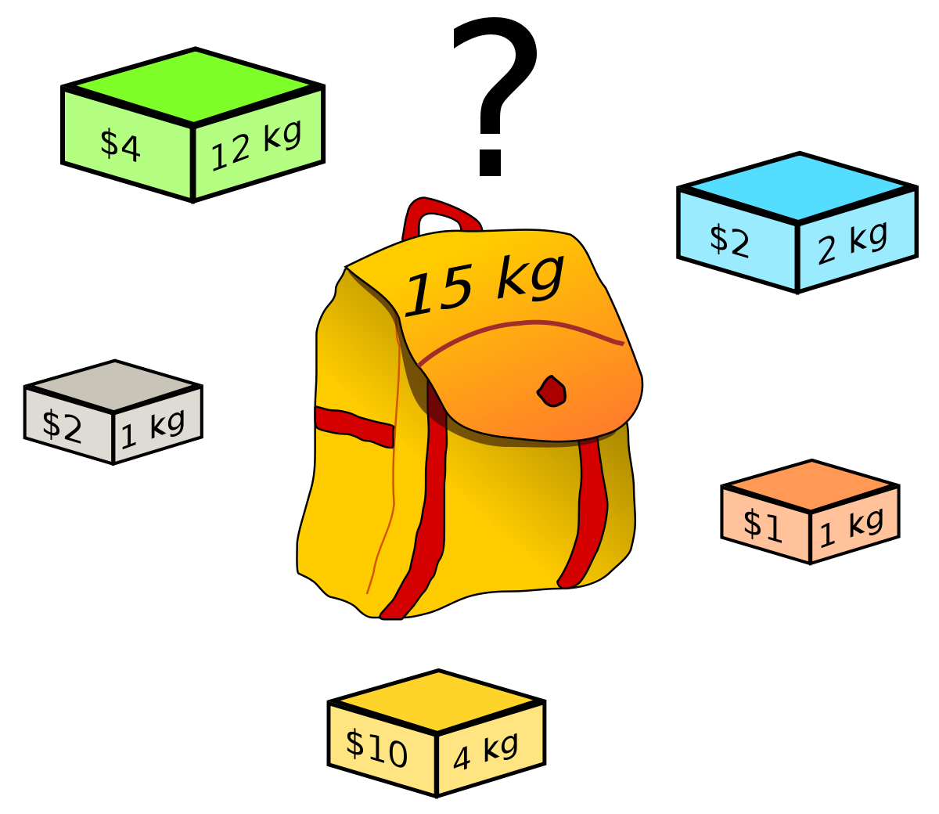
Knapsack problem
Given a set of items, each with a weight and a value, determine the number of each item to include in a collection so that the total weight is less than or equal to a given limit and the total value is as large as possible.
It derives its name from the problem faced by someone who is constrained by a fixed-size knapsack and must fill it with the most valuable items.
The problem often arises in resource allocation where the decision makers have to choose from a set of non-divisible projects or tasks under a fixed budget or time constraint, respectively.

Slide 34
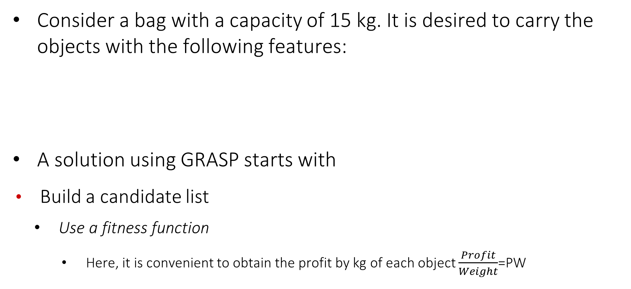
Example
Consider a bag with a capacity of 15 kg. It is desired to carry the objects with the following features:
A solution using GRASP starts with
Build a candidate list
Use a fitness function
Here, it is convenient to obtain the profit by kg of each object $\frac{Profit}{Weight}$=PW
Object | 1 | 2 | 3 | 4 | 5 | 6 | 7
Profit | 10 | 5 | 15 | 7 | 6 | 18 | 3
Weight(kg) | 2 | 3 | 5 | 7 | 1 | 4 | 1

Slide 35
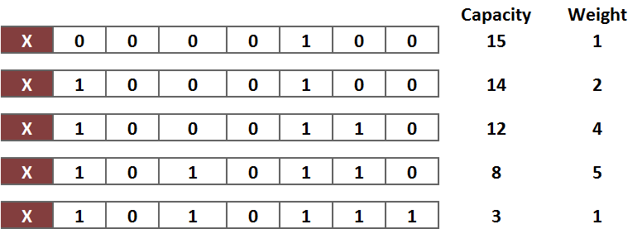
Example
Object | 1 | 2 | 3 | 4 | 5 | 6 | 7
Profit | 10 | 5 | 15 | 7 | 6 | 18 | 3
Weight(kg) | 2 | 3 | 5 | 7 | 1 | 4 | 1
PW | 5 | 1.6 | 3 | 1 | 6 | 4.5 | 3
Build a feasible solution, assign elements according to PW
Greedy solution
Profit=52

Slide 36
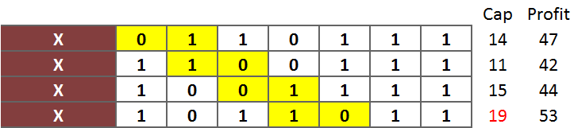
Local search: Strategy 1
Local search: From feasible solution, search pairs 1-0 or 0-1 only one step a head and change their values, then evaluate

Slide 37
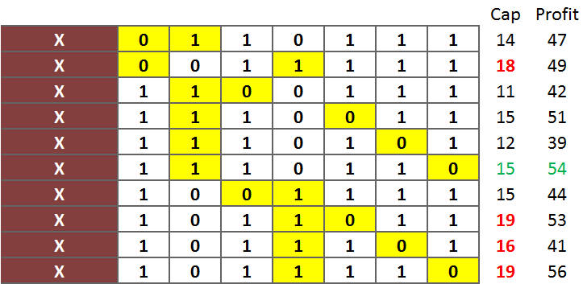
Local search: Strategy 2
Local search: From feasible solution, search pairs 1-0 or 0-1 in the whole neighborhood, and change the values, then evaluate

Slide 38
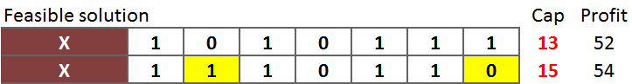
Solution
Conclusions:
Strategies for fitness function and local search make the difference in the quality of the solution

